Slide 1




NEXT GEN EMPLOYABILITY PROGRAM
Creating a future-ready workforce
Team Members
College Name
Sudent Name :S.MEHANTHIKA
Student ID :au513521243013
ANNAI MIRA COLLEGE OF ENGINEERING AND TECHNOLOGY

Slide 2

CAPSTONE PROJECT SHOWCASE
Project Title
Building Bus Reservation System using Python and Django
Abstract | Problem Statement | Project Overview | Proposed Solution | Technology Used | Modelling & Results | Conclusion

Slide 3
Abstract
At its core, BusBooker abstracts the complexities of bus reservation into simplified entities, actions, and technical components.
Users interact with buses and passengers, performing actions like booking, canceling, and managing reservations, all facilitated by underlying database tables and backend functions.
This abstraction enables a user-friendly experience while maintaining robust functionality and scalability behind the scenes.
Source :

Slide 4
Problem Statement
Create a bus reservation system for a transportation company operating in a specific region.
The system should allow users to search for buses based on their origin, destination, date of travel, and preferred timings.
Users should be able to select seats from available options, input passenger details, make payments securely, and receive booking confirmations via email or SMS.
Admin functionalities should include managing bus schedules, updating seat availability, processing cancellations, generating reports, and handling customer support queries.
Source :

Slide 5
Project Overview
Developing BusBooker, a user-friendly bus reservation system, enabling passengers to search, book, and manage their travel seamlessly while providing admin tools for scheduling, seat management, and customer support.
Powered by secure payment integration and robust database management, ensuring reliability and efficiency.
Source :

Slide 6
Proposed Solution
.
The proposed solution is to develop BusBooker, a comprehensive bus reservation system, featuring user-friendly interfaces for passengers to search, book, and manage their travel seamlessly.
Admin functionalities will include scheduling, seat management, and customer support tools, all powered by secure payment integration and robust database management for reliability and efficiency.
Source :

Slide 7
Objectives
OBJECTIVES:
BusBooker aims to streamline bus bookings for passengers while enhancing management capabilities for administrators. Key objectives include user convenience, reliability, administrative efficiency, scalability, security, user satisfaction, and business growth.
BusBooker strives to simplify the bus booking process for passengers while providing efficient tools for administrators to manage operations.
This involves ensuring a seamless experience for users through features like easy search, seat selection, and secure payments.
Administrators benefit from functionalities such as scheduling, seat management, and customer support tools.The system aims for reliability, scalability, and security to foster trust among users and facilitate business growth.
Ongoing enhancements and responsiveness to user feedback further contribute to overall satisfaction and success.
Source :

Slide 8


Technology Used
Front-end
Back-end
Source :

Slide 9
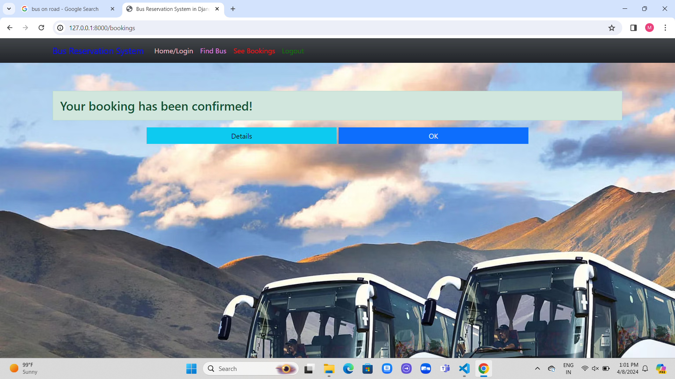
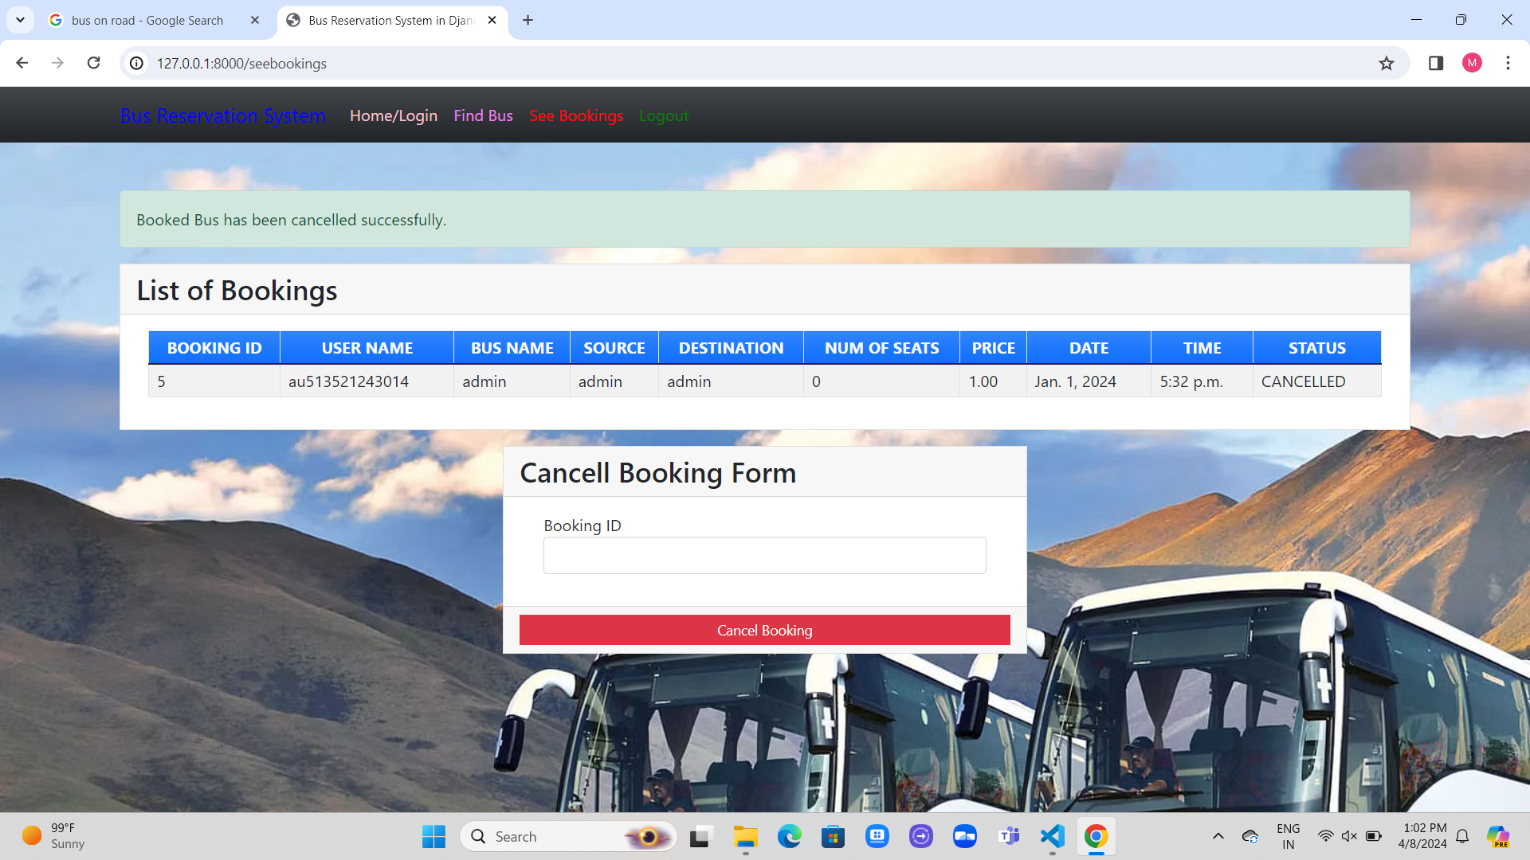
Modelling and Results

Slide 10
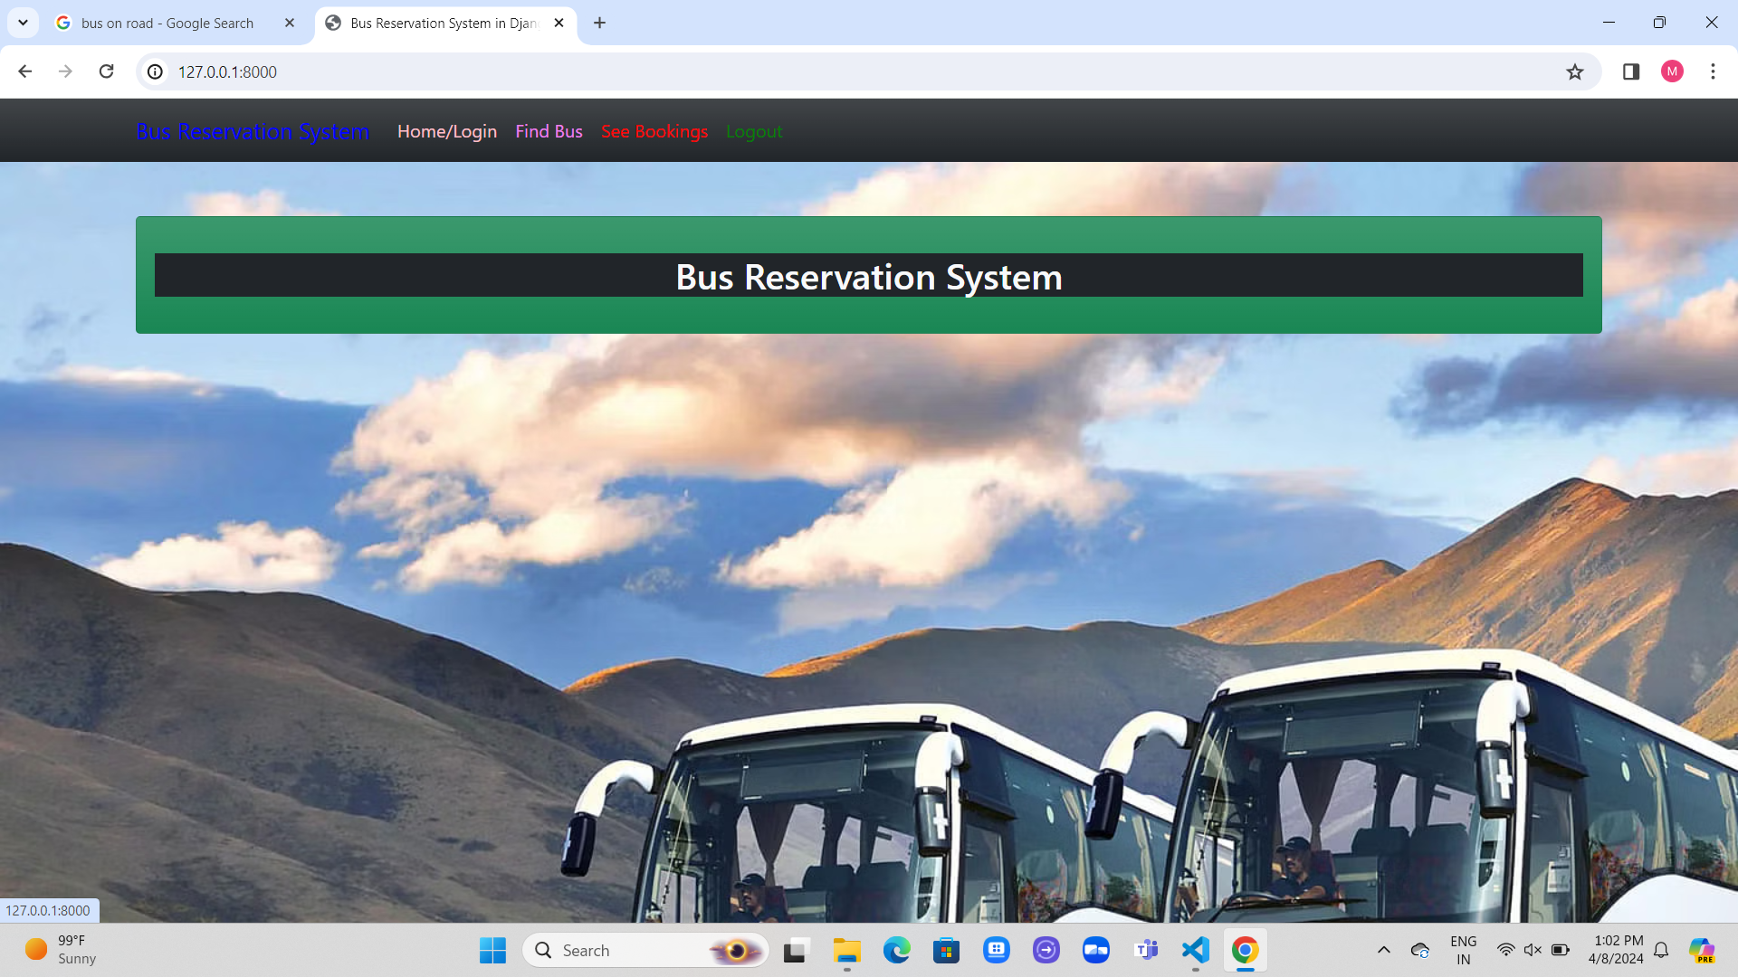
Homepage

Slide 11
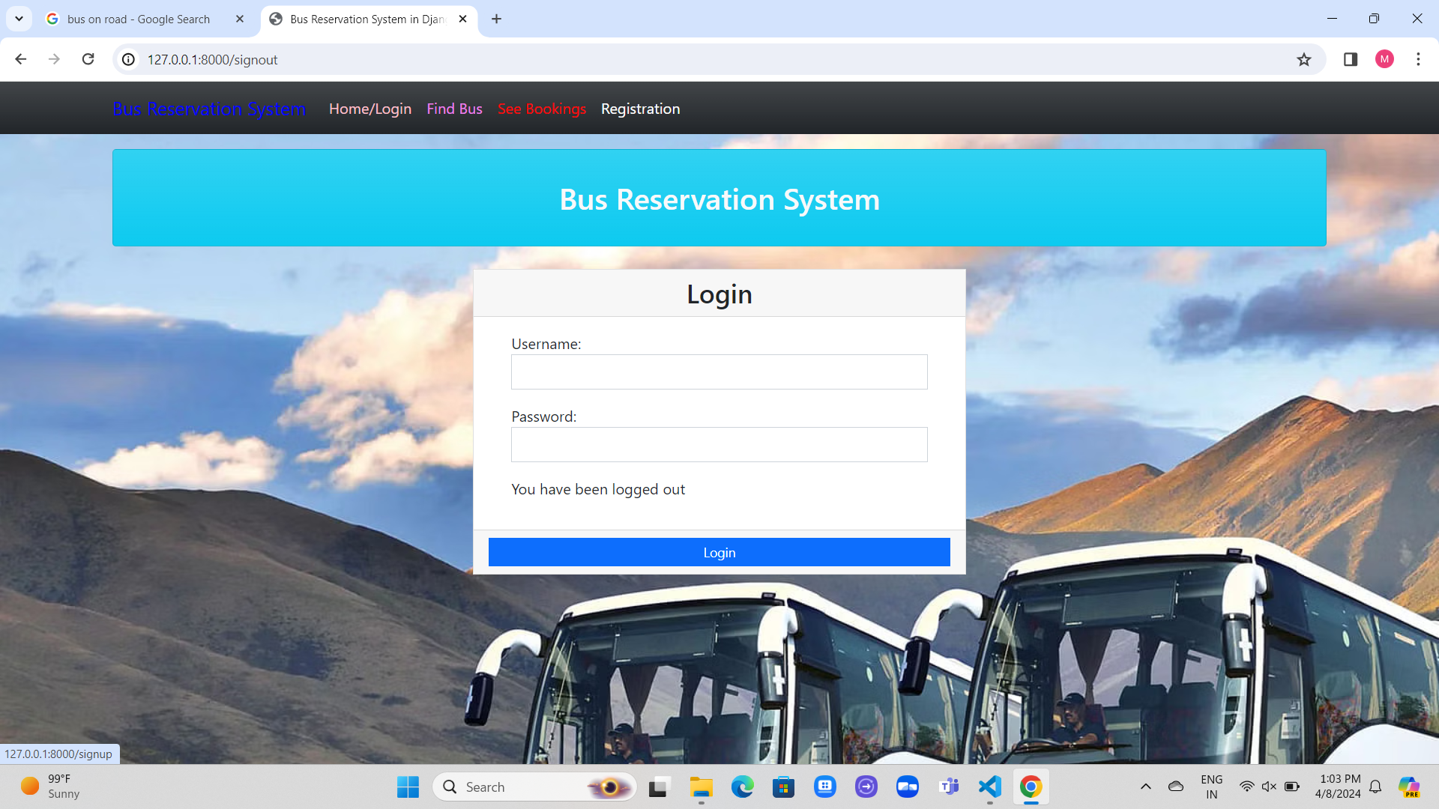
Login-Page

Slide 12
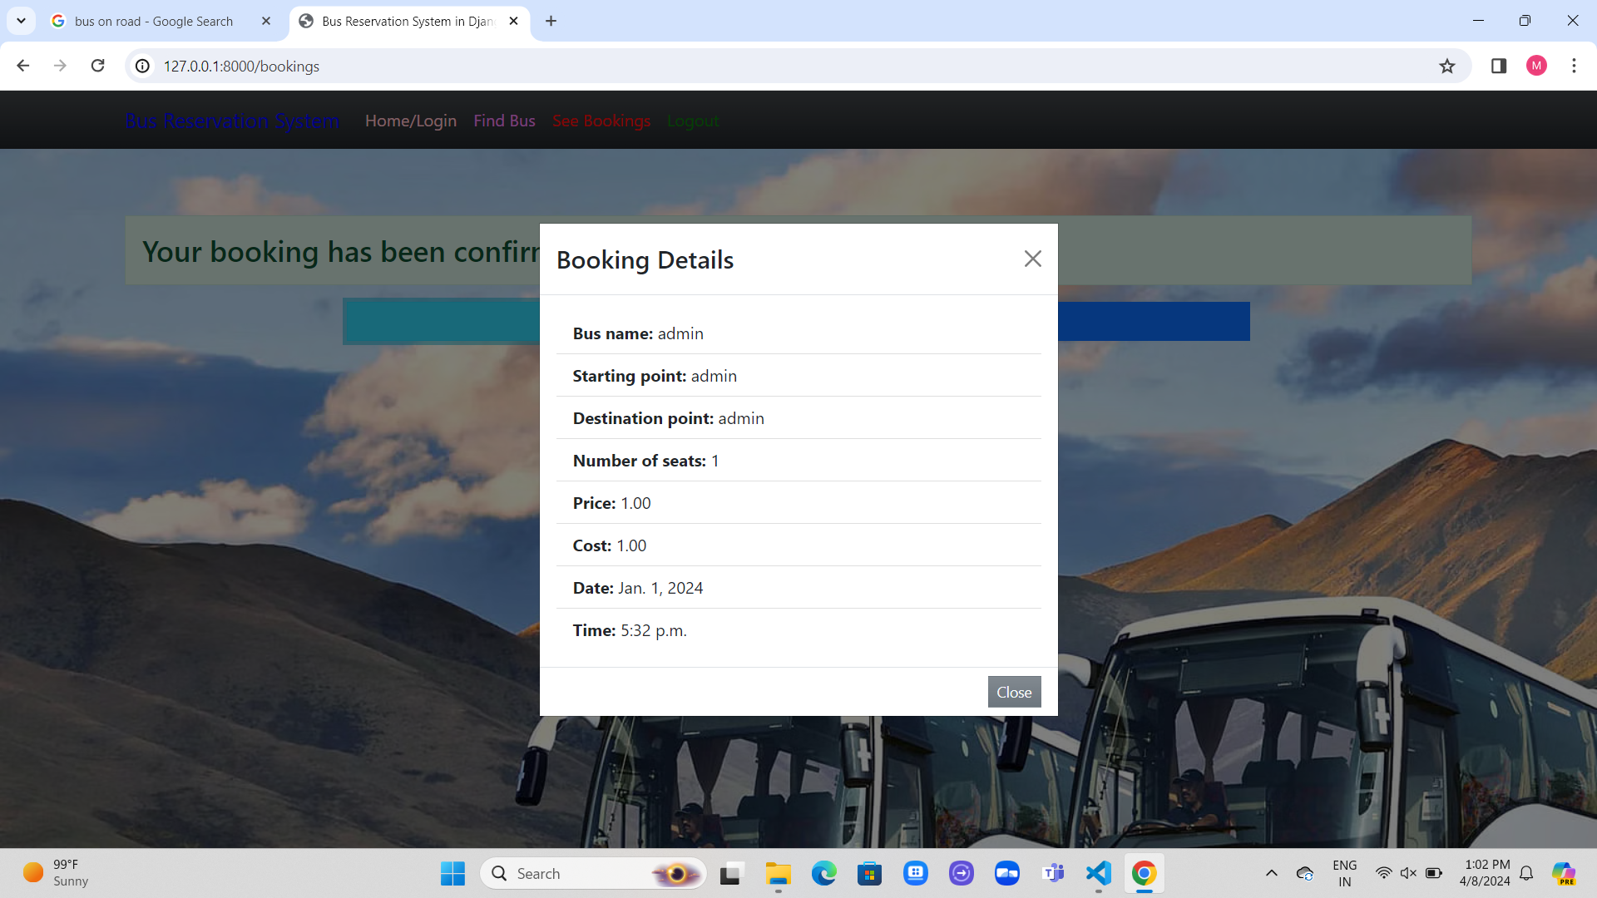
New User Registration

Slide 13
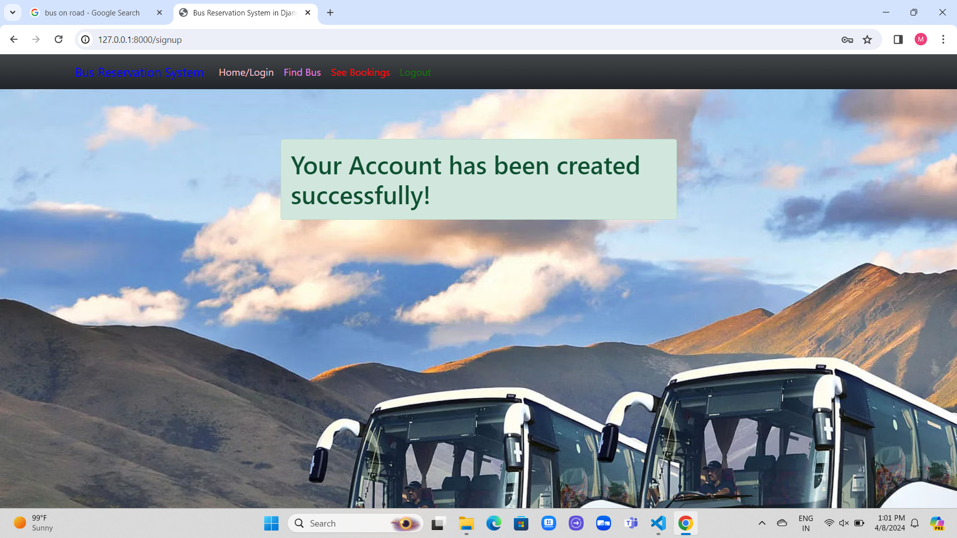
Registration Successfull

Slide 14
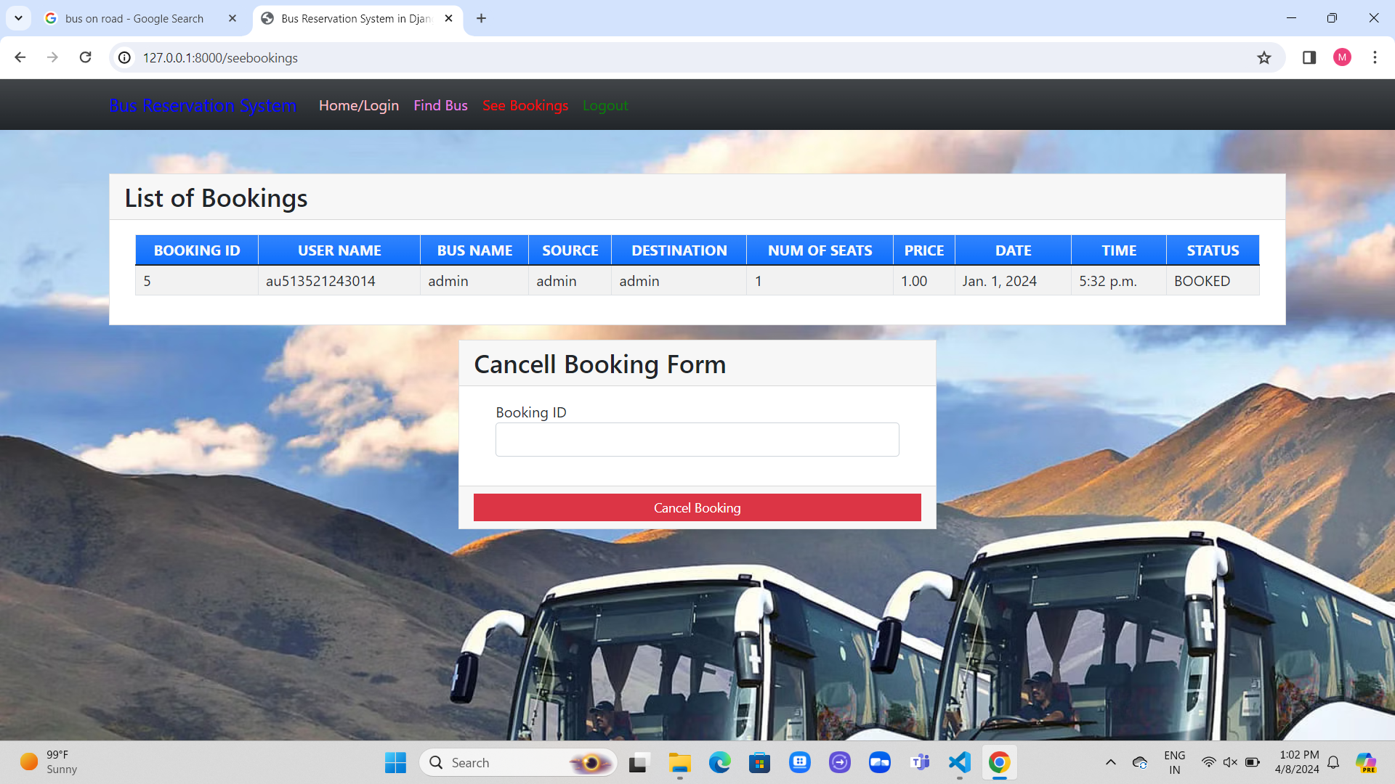
Find Bus

Slide 15
Booking Cancellation:

Slide 16
Future Enhancements:
The future enhancements outlined for BusBooker aim to improve the overall user experience and expand the functionality of the platform.
**Mobile App Development:** Creating a mobile app would enable users to access BusBooker from their smartphones, making it more convenient to book bus tickets anytime, anywhere.
**Personalized Recommendations:** By analyzing user data, BusBooker can offer personalized recommendations tailored to each user's preferences and past booking history, enhancing user satisfaction and increasing the likelihood of repeat bookings.

Slide 17
Conclusion
In conclusion, the development of BusBooker represents a significant step forward in the realm of bus reservation systems, providing users with a convenient and efficient platform for booking their travel needs.
With its user-friendly interfaces, secure payment integration, and robust backend functionalities, BusBooker offers a seamless booking experience for passengers while also providing powerful administrative tools for managing bus schedules and customer support.
Future enhancements such as mobile app development and personalized recommendations will further elevate the platform, ensuring continued growth and customer satisfaction in the ever-evolving landscape of transportation services.
Source :

Slide 18
Thank You!
Notes:
Thank You !!

